Slide 1
Worker’s Productivity
What makes them tick?

Slide 2
Main Aim
The main presentation aim is for general public to know what attributes or factors influencing worker’s productivity and able to relate this to their own workplaces.

Slide 3
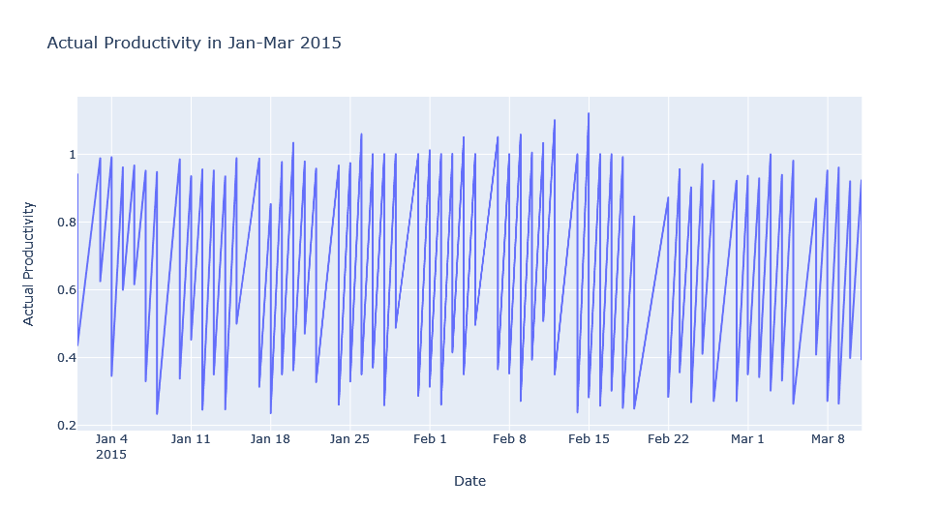
The Problem

Slide 4
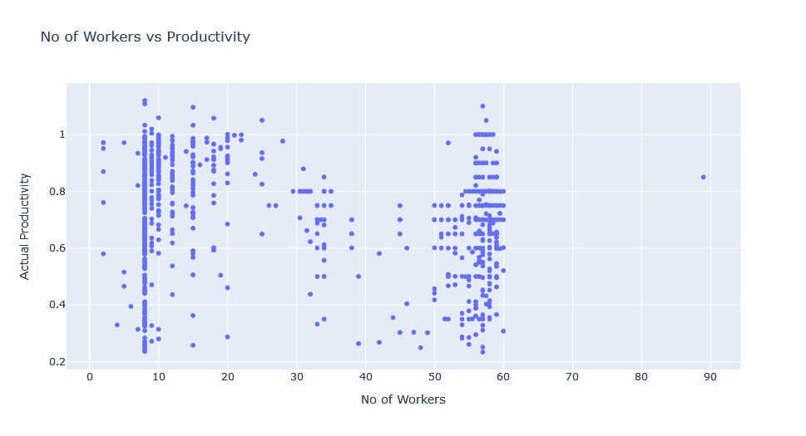
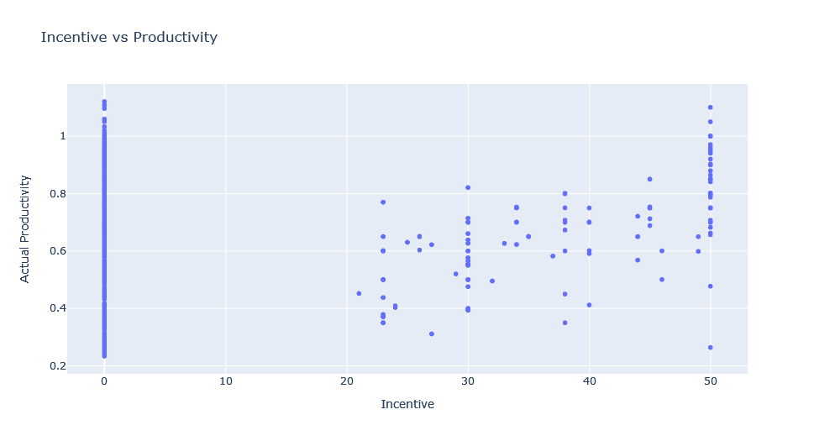
Insights 1

Slide 5
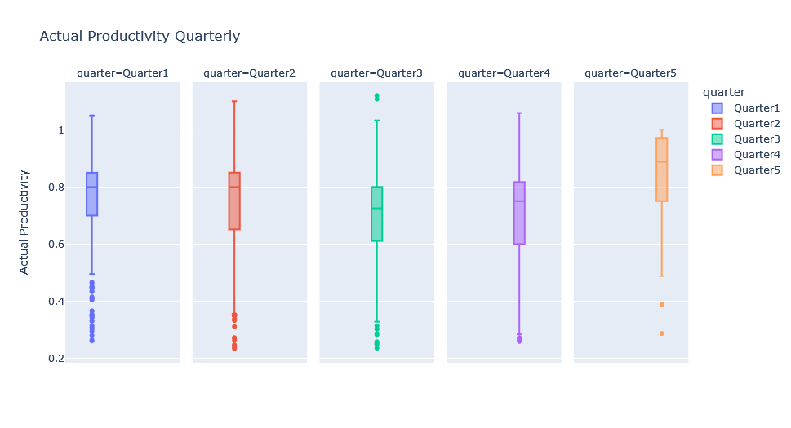
Insights 2

Slide 6
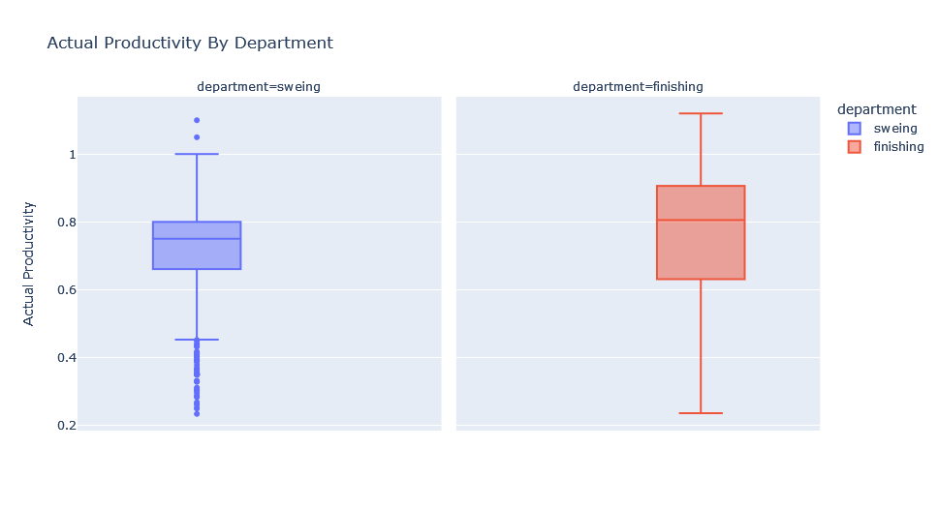
Insights 3

Slide 7
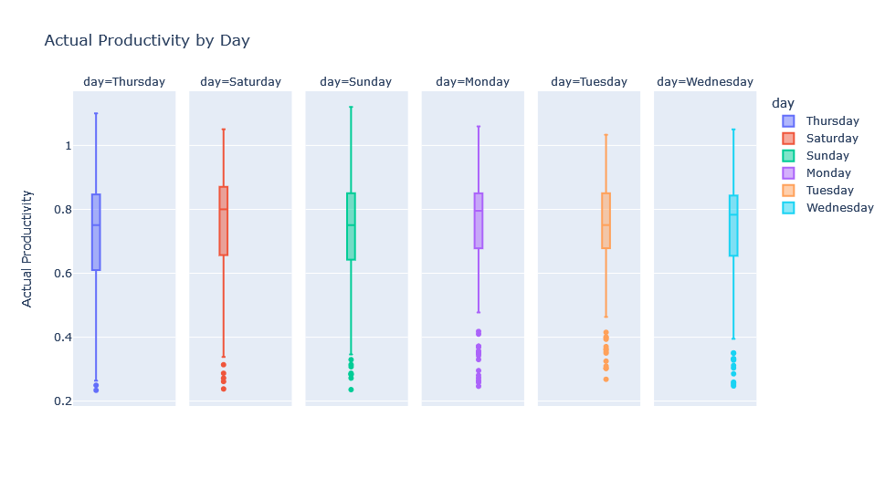
Insights 4

Slide 8
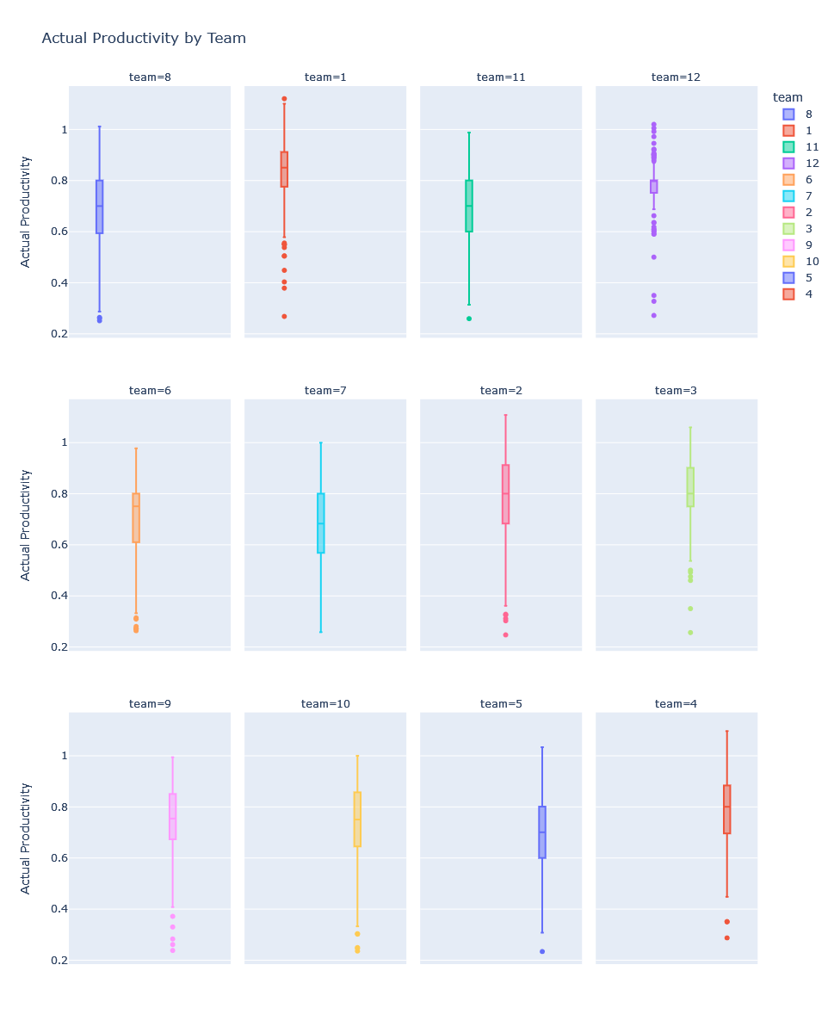
Insights 5

Slide 9
Thanks
Do you have any questions?
addyouremail@freepik.com
+00 000 000 000
yourcompany.com
Please keep this slide for attribution

